Slide 1
The Story of Lacy and Andrew
Does one size fit all?
  Lacy is 4’ 10” (147 cm)
  Andrew is 6’ 10” (208 cm)

Slide 2
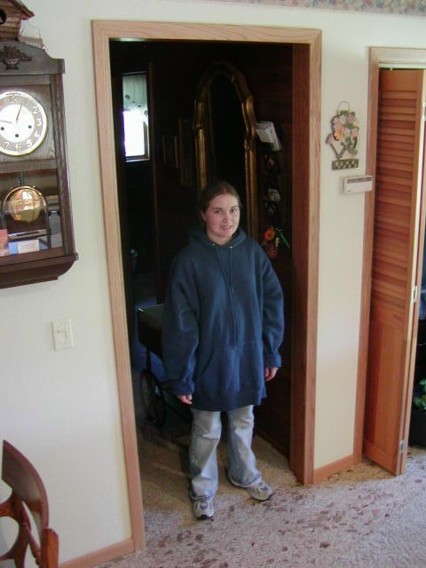

Slide 3
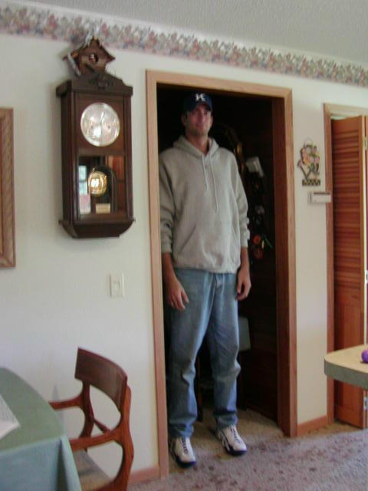

Slide 4
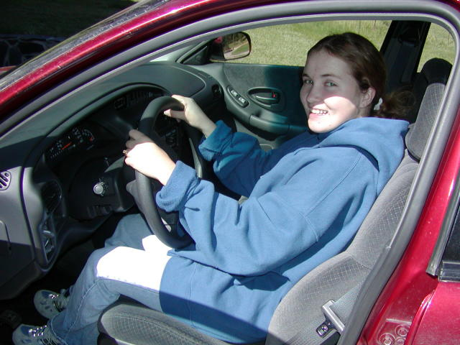

Slide 5
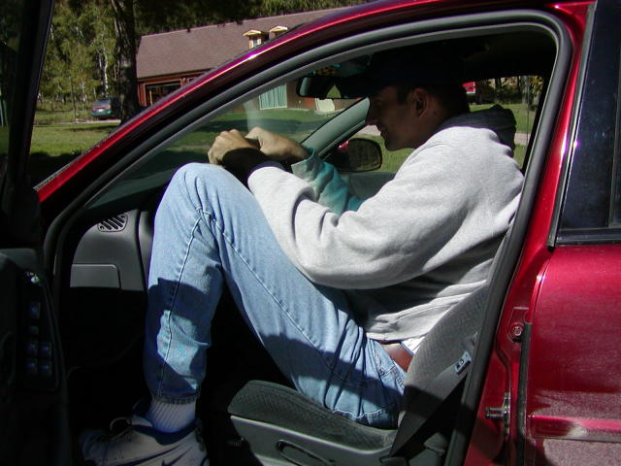

Slide 6
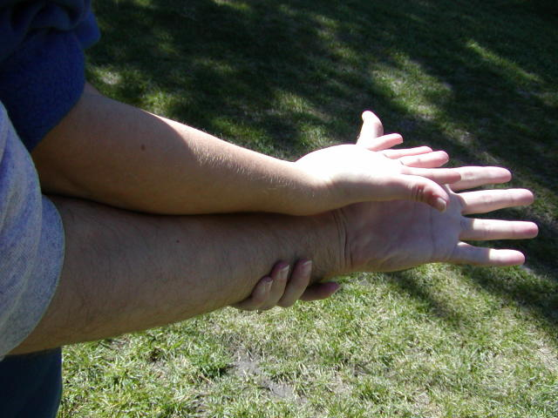

Slide 7
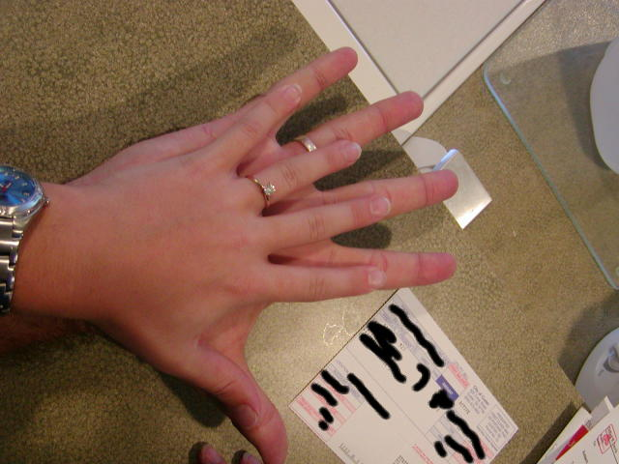

Slide 8
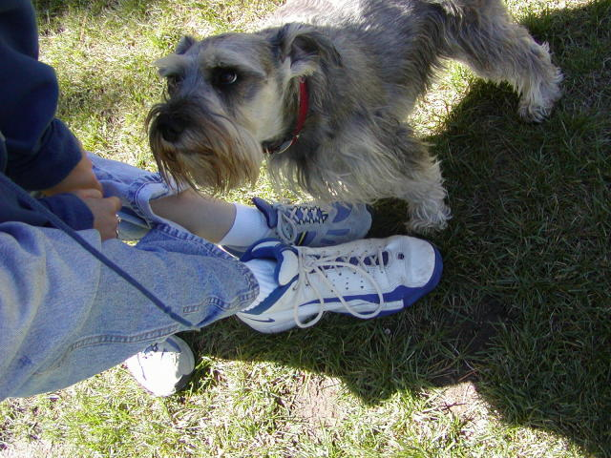

Slide 9
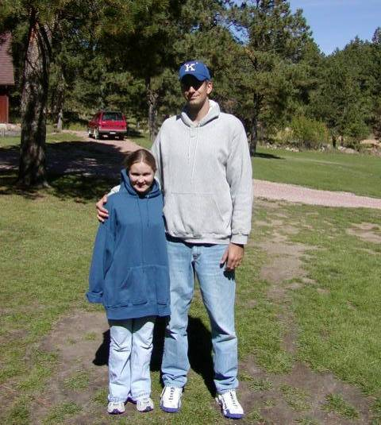
Love conquers all – even anthropometry!

Slide 10
Available Body Size Data
Dimensions for 1988 US Army personnel
  Table 1-10a (Tables 1-10 b and c for comparison)
North American
  Main difference is weight
    Chest depth, Abdominal depth, Hip breadth
  5th, 50th, 95th percentile measures (p) and standard deviation (s)
Most populations not thoroughly measured (small n)
  Mean and standard deviation not true indicators of underlying population

Slide 11
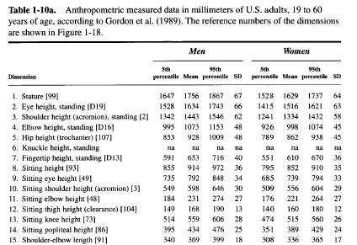

Slide 12
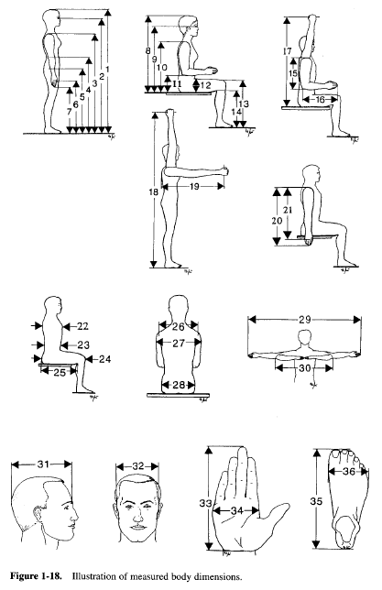

Slide 13
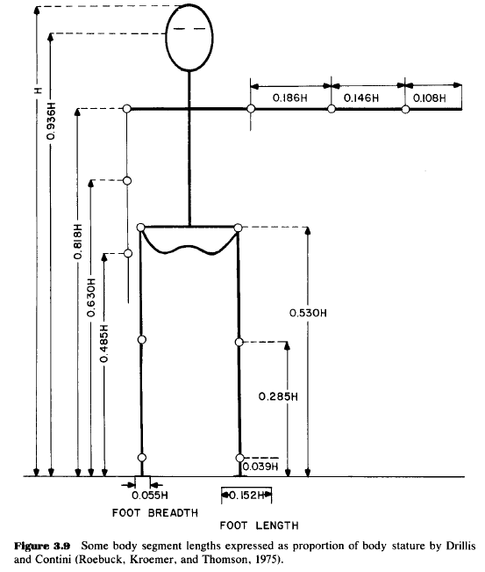

Slide 14
